Slide 1
U.S. Federal Court System
With a Focus on Pennsylvania
Formatting © 2033 The Pennsylvania State University. Based on information from U.S. Courts.gov and Wikipedia.

Slide 2
Federal Court System Regional Levels
U.S. Supreme Court
U.S. Courts of Appeal
(13 Circuits)
District Courts
(94 total, part of Circuits 1-11 + DC)

Slide 3
13 Circuits
(PA in 3rd Circuit)
Circuits 1-7
Circuits 8-11+
1st Circuit – Boston
2nd Circuit – New York
*3rd Circuit – Philadelphia
4th Circuit – Richmond
5th Circuit – New Orleans
6th Circuit – Cincinnati
7th Circuit – Chicago
8th Circuit – St. Louis
9th Circuit – San Francisco
10th Circuit – Denver
11th Circuit – Atlanta
District of Columbia –
  Washington D.C.
Federal Circuit (D.C.)
  specialty courts in Washington D.C.

Slide 4
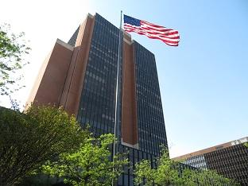
3rd Circuit (Philadelphia)
Districts
District of Delaware
District of New Jersey
*Eastern District of Pennsylvania
*Middle District of Pennsylvania
*Western District of Pennsylvania
District of the Virgin Islands
Photo: James A. Byrne U.S. Courthouse in Philadelphia

Slide 5
Duty Stations in the 3rd Circuit
3rd Circuit
Delaware
Philadelphia
U.S. Virgin Islands
Wilmington
St. Thomas/St. John (Charlotte Amalie)
St. Croix (Christiansted)
New Jersey
Camden
Newark
Trenton
Eastern PA
Middle PA
Western PA
Allentown
Easton
Philadelphia
Reading
Harrisburg
Scranton
Wilkes-Barre
Williamsport
Erie
Johnstown
Pittsburgh

Slide 6
Pennsylvania Districts

Slide 7
Eastern Pennsylvania

Slide 8
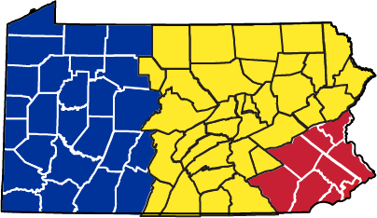
Eastern PA Counties and Courts
Berks
Bucks
Chester
Delaware
Lancaster
Lehigh
Montgomery
Northampton
Philadelphia
Allentown
Easton
Philadelphia
Reading
Three U.S. federal court districts of PA. The red is the Eastern district.

Slide 9
Middle Pennsylvania

Slide 10
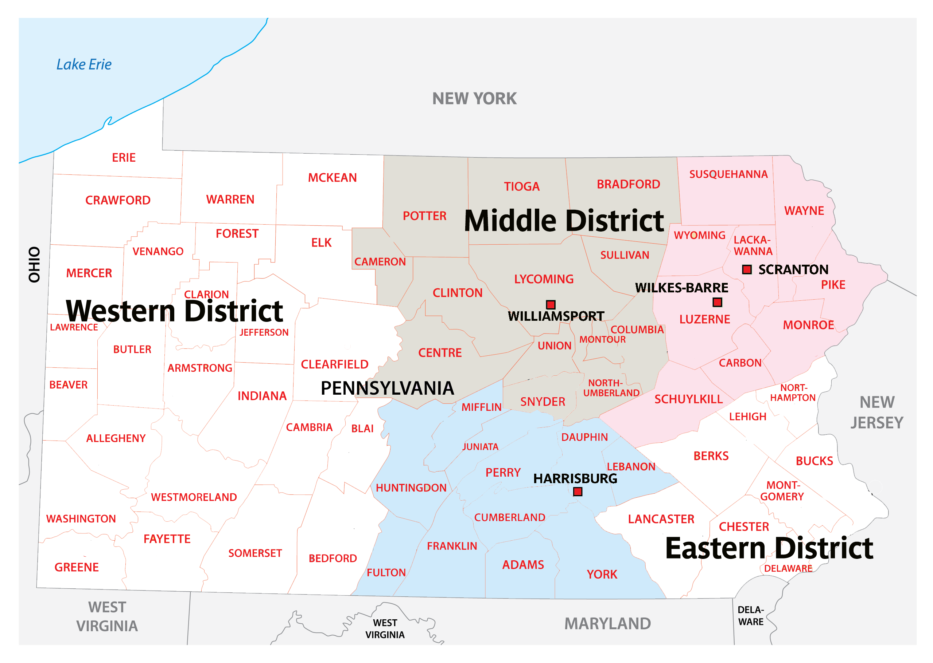
Middle PA Counties and Courts
Central and northeastern PA
Harrisburg
Scranton
Wilkes-Barre
Williamsport
Middle District divided into three sections.

Slide 11
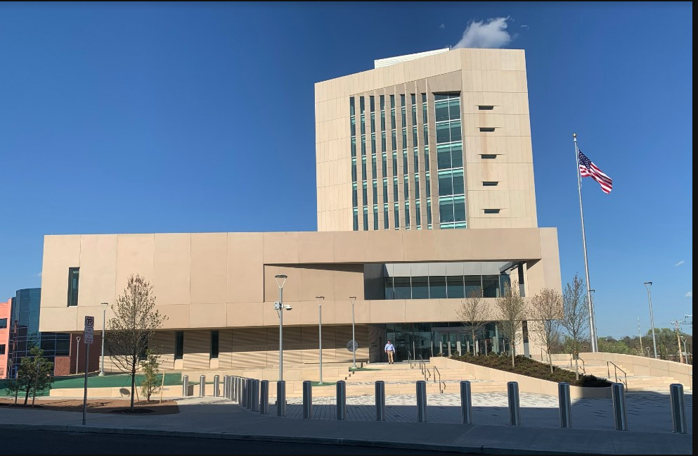
Harrisburg (Middle Pennsylvania)
Counties
Bradford
Cameron
Centre
Clinton
Columbia
Lycoming
Montour
Northumberland
Potter
Snyder
Sullivan
Tioga
Union
Photo: Sylvia H. Rambo U.S. Courthouse in Harrisburg

Slide 12
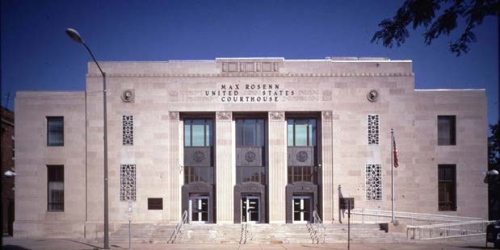
Scranton/Wilkes-Barre (Mid PA)
Counties
Carbon
Luzerne
Monroe
Lackawanna
Pike
Schuylkill
Susquehanna
Wayne
Wyoming
Photo: Max Rosen Courthouse in Wilkes-Barre

Slide 13
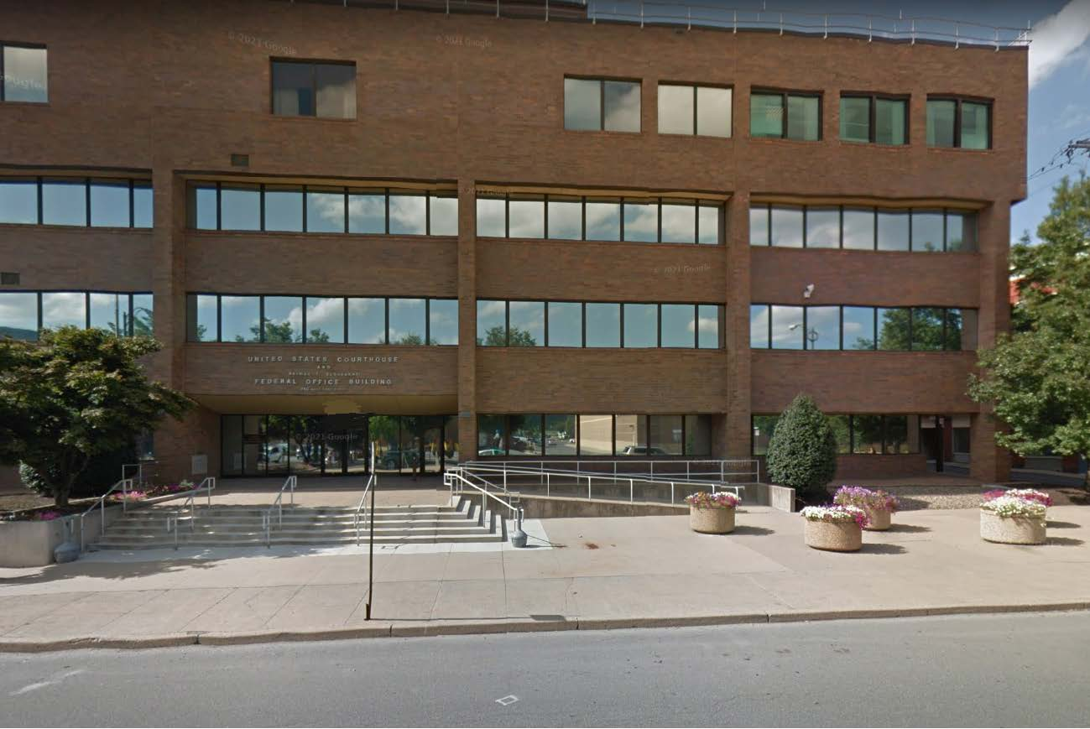
Williamsport (Middle Pennsylvania)
Counties
Bradford
Cameron
Centre
Clinton
Columbia
Lycoming
Montour
Northumberland
Potter
Snyder
Sullivan
Tioga
Union
Photo: Herman T. Schneebeli Federal Bldg. & U.S. Courthouse in Williamsport

Slide 14
Western Pennsylvania

Slide 15
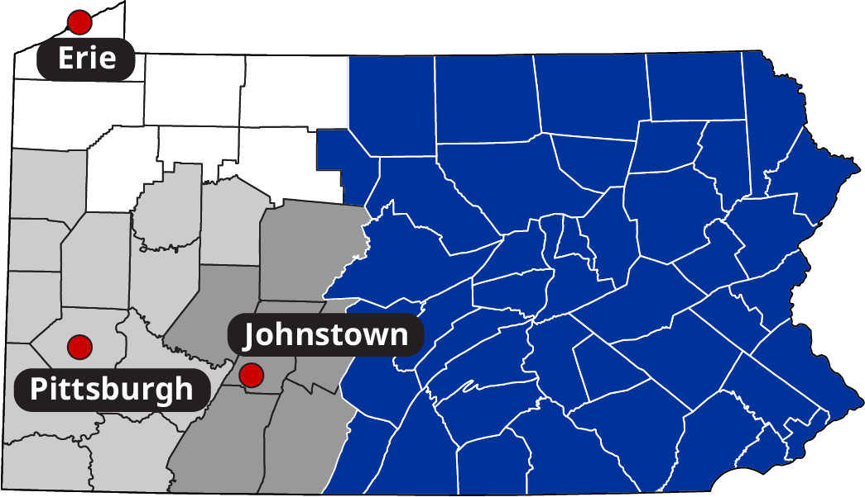
Western PA Counties and Courts
Western PA
Erie
Johnstown
Pittsburgh
Western District divided into three sections.

Slide 16
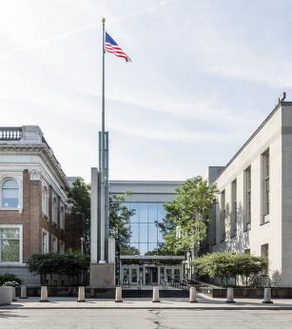
Erie (Western Pennsylvania)
Counties
Crawford
Elk
Erie
Forest
McKean
Venango
Warren
Photo: Erie Courthouse and Federal Building

Slide 17
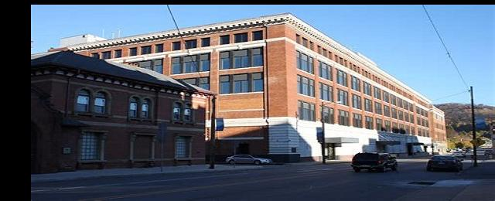
Johnstown (Western Pennsylvania)
Counties
Bedford
Blair
Cambria
Clearfield
Somerset
Photo: Johnstown U.S. Courthouse

Slide 18
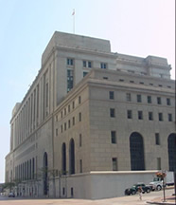
Pittsburgh (Western Pennsylvania)
Counties
Allegheny
Armstrong
Beaver
Butler
Clarion
Fayette
Greene
Indiana
Jefferson
Lawrence
Mercer
Washington
Westmoreland
Photo: Joseph F. Weis, Jr. U.S. Courthouse in Pittsburgh

