Slide 1
Using Word Templates to Promote Accessible Headings & Tables
Elizabeth J. Pyatt, Ph.D. IT Accessibility
Lecturer, Linguistics
accessibility@psu.edu

Slide 2
For Today’s Session
Accessible Syllabus as a Starting Place
Explaining “Semantic” vs. “Visual”
Different Instructor Audiences
Template Features & Demo
Outreach Efforts
Where to Next?

Slide 3
Who am I? Penn State Accessibility IT/Lecturer
Accessibility IT
Linguistics
Testing, training
Even faculty?
And producer of ALT Text
I’ve seen what a syllabus looks like ”in the wild”
And many diagrams
A communication science
And a cognitive/ anthropological science
Need to describe what is actually happening vs. what people think is/should be happening

Slide 4
Why Train Instructors
Document Flexibility
Instructors work at 3 am
News happens at 3 am
No time for “remediation”
Add Efficiency
Become a “power user”?
Improved ALT
Instructors knows importance of their diagrams
Make content work for students sitting in the back

Slide 5
Why Syllabus Accessibility?

Slide 6
Why the syllabus?
Every course has one
Key document for students, instructors, administrators
Includes the following
Headings
Links
Tables or lists
Images?
Color?
Notes:
M A

Slide 7
Can Expand To....
Homework Assignments
Handouts
And also templates for
Academic articles
Reports
Newsletters
Even an embroiderers’ guild newsletter

Slide 8
Explaining Semantics

Slide 9
Have you seen these in Word files?
Visual headings
Bolding, italics, larger, underlined, different fonts, color change
See also visual table headers
Merged table cells
Title of table = first row
“Spring Break” schedule row
Other....
Unusable Links
Long links
Repetitive (e.g. “here” or ”Assignment Details”

Slide 10
How hard are these to explain?
Options (on a scale of 1-5)
Image Alt Text
Contrast
Headings
Table Headers
Usable Link Text

Slide 11
“Linguistics” and Accessibility
Semiotics
Multilingualism
Signal vs. Semantics
Visual formatting can be a signal for semantic structure
Can be subconscious
Signal interference is possible
Stroop Effect
Blue should be blue!
Multilingualism
Able to switch grammars and modalities
Red =
“Danger” (English)
“Peligro” (Spanish)
“Avertissement” (French)

Slide 12
Find the Signals, Explain the Meaning Any headings?
Semiotics
Multilingualism
Signal vs. Semantics
Visual formatting can be a signal for semantic structure
Can be subconscious
Which visual formatting cues are on the slide?
What do they mean?
Multilingualism
Able to switch grammars and modalities
100 =
Hundred (English)
Ciento (Spanish)
Cent (French)
Céad (Irish)

Slide 13
Signals =
Bold =
Emphasis
Color change =
Extreme emphasis/warning
How do you do indicate this for a screen reader?
Large text (title + section labels) =
Headings
Box =
Content sections
Probably can be skipped in description

Slide 14
Why are headings important? And what are they?
Heading
a title at the head of a page or section of a book. Oxford Languages via Google
Headings communicate the organization of the content on the page. Web browsers, plug-ins, and assistive technologies can use them to provide in-page navigation. W3C Consortium

Slide 15
Another Answer Clickable Table of Contents
Headings Map
Document View

Slide 16
Heading Rules
Heading 1 = Document Title
“A Heading 1 is the main content heading. There is generally just one Heading 1 per document, although it is possible to have more than one (e.g., a journal where each article is a Heading 1).
Course title = Heading 1
Title style NOT in Headings Map by Default
Heading 2 = Main Section
Headings 3-6 = Lower Subsections

Slide 17
Why Custom Templates
Notes:
Elizabeth from here

Slide 18
The Blue Headings....
My complaints
Thin weight font (fixed)
Still normal weight
Hard to distinguish levels IMO (fixed)
Sizes are now larger
Blue?
Not as legible as black
Not part of academic brand

Slide 19
2023 Default Table Formatting Which is accessible? (Top...I Think)
Even if “Header/First Column” are checked, the visual formatting may not change.
2024 – bolding in headers

Slide 20
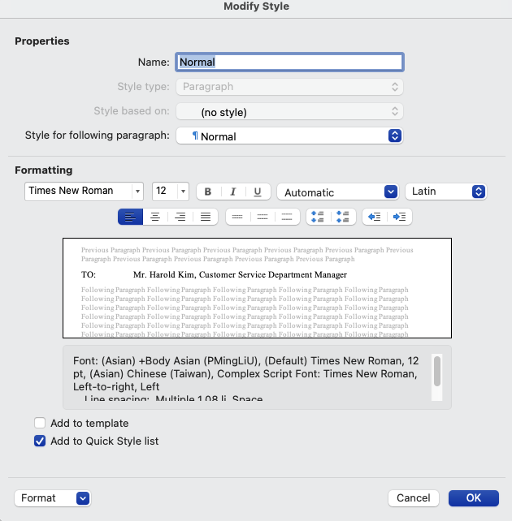
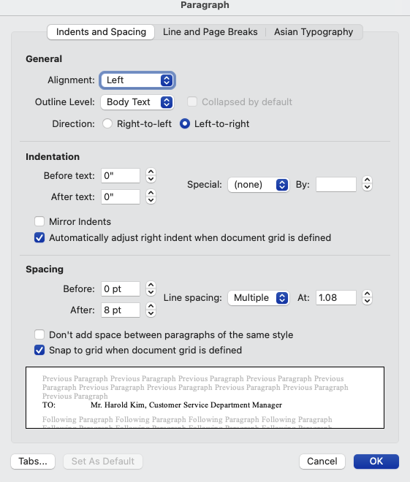
Can you change defaults?
Yes...but it’s tricky

Slide 21
Syllabus Creator Audience
1. Keep it simple
No frills needed
Minimal training if possible
2. Wants formatting flexibility
Can visual interest be added?
Minimal training if possible
But more needed than just “no frills”
3. Department/College/Campus Templates?
Edited by program coordinators and administrative support staff

Slide 22
Word Accessibility File Needs
Basic
Usable Link Text + Hyperlink Editor (Adv?)
Heading Styles (blue??)
Table Headers (w/ formatting check)
Image Alt Text
And Also
Accessible “textboxes”
Tweaking styles
Color usage
Drop caps? Columns?

Slide 23
Template Features

Slide 24
Template Features Listed
Modified styles
Mostly colored black & bold
Added accessible ”textbox” styles
Different font options
Times New Roman option
Modified Microsoft default
Calibri Large & Georgia large
Blue Bars
Accessible Table options
All options comply with contrast guidelines
Heading format automatic
Policy Language/Links?
No university-level required language.
Standards and requirements set by campus/college/program/department leads

Slide 25
Sans Serif Large (Verdana)

Slide 26
Styles Pane and Tables

Slide 27
Tables: Default vs. Custom Tables

Slide 28
Table: Less Usable Defaults Invisible Headers and Low Contrast

Slide 29
Accessible Table Choices
Visible Headers!
Good color contrast

Slide 30
Custom Table Style The Top is definitely accessible
When the “Header” option is checked, the top row changes to dark blue.

Slide 31
Serif Large

Slide 32
Serif for “Unusual Symbols”
Sans Serif
Serif
Phonetics: ŋ,ɲ,ñ,ṇ,n̩
Greek Letters: α,β,γ,δ,ζ,χ
Phonetics: ŋ,ɲ,ñ,ṇ,n̩
Greek Letters: α,β,γ,δ,ζ,χ

Slide 33
Times New Roman Somewhat Popular

Slide 34
Headings w/ Pizazz (Still Accessible) Blue Bars Template

Slide 35
Template Extensions

Slide 36
College of Nursing

Slide 37
Policy Links URLs visible, but inactive

Slide 38
Syllabus & Homework Handout Book Antiqua/Palatino

Slide 39
Student Assignments

Slide 40
Newsletters

Slide 41
Future Possibilities
Work with academic units?
COMM 30 - Public Speaking
Just change instructor/TA names
More Non-Syllabus Templates?
OER Repositories
Lab Reports (student & non-student)
Academic Articles
Dissertations (exists at Penn State)
PowerPoint? Open Office?
Also InDesign

Slide 42
Find the Templates

Slide 43
Penn State Syllabus Templates
Available on
accessibility.psu.edu/syllabustemplates

Slide 44
Trainings in Word Accessibility
Resource | Audience/Content/Level
Templates | Downloadable Word files for instructors. Basic. accessibility.psu.edu/syllabustemplates
Learning Path | Canvas Course for anyone with exercises. Medium.
Quickstart Guide Doc | Detailed Users Manual. Comprehensive. accessibility.psu.edu/handouts accessibility.psu.edu/tips
Train the Trainer | Instructional Designers, Web Liaisons. Customized.
Presentations | Basic Template (Schreyer) Three-Part Series (IT Learning & Development)

Slide 45
Word Module (Screencaps) Accessibility Learning Path(s)
Audience: Everyone
Covers
Basics
Some frills
Canvas Platform
Self-Paced
30-60 min
Self check quizzes and practice files

Slide 46
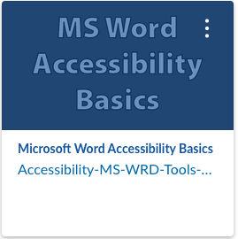
Accessibility Learning Path (ALP) Word Module

Slide 47
Accessibility Learning Path (Canvas Catalog)

Slide 48
Learning Path: Accessibility Practice

Slide 49
Accessibility Quickstart Guides On SharePoint
Audience: Adapt or Create Template
Covers:
Basics
Modifying styles
Drop caps, Smart Art
Column headings
Borders and fillings
Text to tables…
Based on different requests

Slide 50
Quickstart Guide

Slide 51
Questions?

