Slide 1
Building and Re-Building Accessible Tables
Elizabeth J. Pyatt
Penn State
ejp10@psu.edu
See Notes panel for image ALT tags

Slide 2
Outline
Simple Rules for Table Accessibility
Common Errors with Simple Fixes
Complicated Layout Adjustments
Usually involving cell merges
Tricks
Creative formatting
Split tables
Use lists
Restructure data

Slide 3
Pros and Cons of Tables
Pros | Cons
Allows comparison of data across multiple parameters Efficiently consolidate data spatially | Layouts can be confusing (for sighted and unsighted users)

Slide 4
4 Table Rules (WCAG 2.0)
Label all columns, and sometimes rows
As “headers”
A title for all tables
i.e. The “Caption”
Don’t Merge Cells
To facilitate orientation of data points
Don’t rely exclusively on color coded cells
Not everyone perceives color equally
But still useful

Slide 5
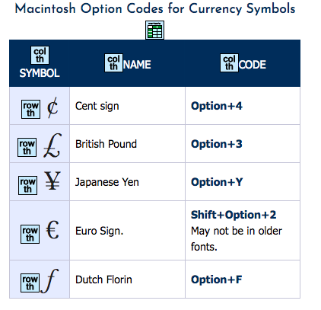
Well Constructed HTML Table Macintosh Option Codes for Currency Symbols

Slide 6
How this helps screen readers
Caption = Read out in list of tables & as intro
Headers
Gives context to data cells
Example
No Headers: Option 4
With Headers: Code, Dutch Florin, Option 4
No Merges
Preserves table column/row identification

Slide 7
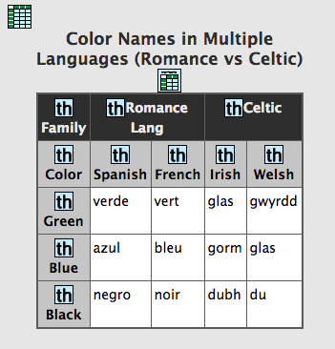
Complex Headers? Color names in 4 languages, 2 Romance & 2 Celtic
Manually code each cell, not just headers
Azul: blue, Spanish, Romance

Slide 8
No Caption Error Table: South American Countries
Name | Population | Capital
Argentina | 43,847,430 | Buenos Aires
Bolivia | 10,887,882 | Sucre and La Paz
Brazil | 207,652,865 | Brasília
Chile | 17,909,754 | Santiago
Deleted Rows | N/A | N/A
Uruguay | 3,444,006 | Montevideo
Venezuela | 31,568,179 | Caracas
Notes:
Table caption is alphabetical list of South American countries

Slide 9
The Other Caption Error Merging 1st Row for Title
Countries of South America
Name | Population | Capital
Argentina | 43,847,430 | Buenos Aires
Bolivia | 10,887,882 | Sucre and La Paz
Brazil | 207,652,865 | Brasília
Chile | 17,909,754 | Santiago
Uruguay | 3,444,006 | Montevideo
Venezuela | 31,568,179 | Caracas
Notes:
Table caption is alphabetical list of South American countries

Slide 10
Caption How-To
HTML
CAPTION tag under TABLE
Use CSS styles to format as needed
Word
Insert Caption (References Tab) or
A small heading level
Format to enhance legibility
Excel
Title in bottom tab and cell A1
PowerPoint/PDF
Title above table

Slide 11
SUMMARY / ALT Text?
SUMMARY vs. CAPTION in HTML
Summary is not visible to sighted users
Caption is visible to everyone
Sighted users also get information
Can use Summary to add supplemental information
ALT Text for Tables in Word?
IMO – same role as Summary

Slide 12
Use of SUMMARY Attribute Explain why symbol read “twice”
Summary explains first two columns, Symbol vs. Name

Slide 13
No Table Heading Error Table: 10 Largest PA Cities
1 | Philadelphia | Philadelphia | 1,567,872
2 | Pittsburgh | Allegheny | 303,625
3 | Allentown | Lehigh | 120,443
4 | Erie | Erie | 98,593
5 | Reading | Berks | 87,575
6 | Scranton | Lackawanna | 77,291
7 | Bethlehem | Northampton | 75,293
8 | Lancaster | Lancaster | 59,218
9 | Levittown | Bucks | 52,400
10 | Harrisburg | Dauphin | 48,904
Notes:
Headings: City, County, 2016 estimated population

Slide 14
PA Cities With Headings
Rank | City | County | 2016 Est Population
1 | Philadelphia | Philadelphia | 1,567,872
2 | Pittsburgh | Allegheny | 303,625
3 | Allentown | Lehigh | 120,443
4 | Erie | Erie | 98,593
5 | Reading | Berks | 87,575
6 | Scranton | Lackawanna | 77,291
7 | Bethlehem | Northampton | 75,293
8 | Lancaster | Lancaster | 59,218
9 | Levittown | Bucks | 52,400
10 | Harrisburg | Dauphin | 48,904

Slide 15
Header How-To
HTML
TH Cell (vs. TD)
SCOPE=“col” or SCOPE=“row” attribute
PDF:
TH tag in table cell
SCOPE=“col” or SCOPE=“row” (Tag Properties)
Word/PowerPoint
Check “Header Row”, ”First Column” in Table Design tab.
Excel – Ranges and headers can be defined for JAWS (http://accessibility.psu.edu/microsoftoffice/excel/)

Slide 16
Creative Formatting Table: Phonetic Features in Spanish Vowels
Vowel | a | i | e | o | u
high | – | + | – | – | +
back | + | – | – | + | +
round | – | – | – | + | +
low | + | – | _ | _ | _
Standard format in linguistics (no borders, empty top left)
Borders would distract sighted practitioners
Sighted students need to learn standard format
Normally formatted with Tabbing
Blank upper left area
Notes:
Cell

Slide 17
Creative Formatting of Borders/Cells Table: Phonetic Features in Spanish Vowels
Vowel | a | i | e | o | u
high | – | + | – | – | +
back | + | – | – | + | +
round | – | – | – | + | +
low | + | – | _ | _ | _
Borders revealed
Border colors had been white
Upper left cell revealed
Text “Vowel” had been white
Don’t forget about center text alignment
Notes:
Cell

Slide 18
Careful with Color Coding Table: Mammal Types
Characteristic | Monotreme (Platypus) | Marsupial (Oppossum) | Placental (Most Mammals)
Warm Blooded
Fur/Hair
Milk Producing
Lays Eggs
Pouch
Live birth, no pouch
Notes:
Red cells are used to indicate feature is present. See next slide for data

Slide 19
Supplement with Symbol Table: Mammal Types (X, has characteristic) Some cells are blank
Characteristic | Monotreme (Platypus) | Marsupial (Oppossum) | Placental (Most Mammals)
Warm Blooded | X | X | X
Fur/Hair | X | X | X
Milk Producing | X | X | X
Lays Eggs | X
Babies in Pouch |  | X
Live birth, no pouch |  |  | X

Slide 20
Undoing Cell Merges
Question
What relationship is the designer trying to convey?
Solutions
Recode headers
Split tables
Use lists
Restructure data
Sometimes as “alternate format” (e.g. periodic table)
Creative formatting can help

Slide 21
Benefits to Un-Merges
WCAG implementation easier and more consistent
Editing simple tables generally simpler
Manipulating rows/columns simpler
Easer to edit individual cells
What about preserving space?
In digital documents, space is cheap

Slide 22
Table: U.S. States Why Merged Headers and Cells?
Name and Postal Code |  | Cities
 |  | Capital City | Largest City
Alabama | AL | Montgomery | Birmingham
Alaska | AK | Juneau | Anchorage
Arizona | AZ | Phoenix
Arkansas | AR | Little Rock
California | CA | Sacramento | Los Angeles
Colorado | CO | Denver
Notes:
Table has merged headers and and come cells for capital and largest city are also merged.

Slide 23
U.S. States Revised Notes: P. Code=Postal Code; 1 means capital & largest city are the same
Name | P. Code | Capital City | Largest City
Alabama | AL | Montgomery | Birmingham
Alaska | AK | Juneau | Anchorage
Arizona | AZ | Phoenix¹ | Phoenix
Arkansas | AR | Little Rock¹ | Little Rock
California | CA | Sacramento | Los Angeles
Colorado | CO | Denver¹ | Denver

Slide 24
Table: Nutrients of Raw Sweet Peppers
Per 100g (3.5 oz.)
Energy | 20 kcal
Carbs Total | 4.64 g
Fat | 0.17 g
Protein | 0.86 g
Vitamins
C | (> 100%) 80.4 mg
B1 (Thiamine) | (5%) 0.057 mg
B2 (Riboflavin) | (2%) 0.028 mg
B3 (Niacin) | (3%) 0.480 mg
Problems
Merged row in middle
No col headers
Why this design?
Notes:
See data on next slide

Slide 25
2 Tables: Nutrients of Peppers Macronutrients vs. Vitamins
Macronutrients
Nutrient | Per 100 g (3.5 oz.)
Energy | 20 kcal
Carbs | 4.64 g
Fat | 0.17 g
Protein | 0.86 g
Vitamins
Vitamin | %age Daily | Per 100 g
C | >100% | 80.4 mg
B1 (Thiamine) | 5% | 0.057 mg
B2 (Riboflavin) | 2% | 0.028 mg
B3 (Niacin) | 3% | 0.480 mg
Notes:
Nutrients split in macronutrients versus vitamins

Slide 26
Table: Germanic Language Family
Main Branch | Sub Branch | 3rd | Lang Names | Code
East (gme) |  |  | Burgundian | qlb
 |  |  | Gothic | got
 |  |  | Vandalic | xvn
North (gmq) =Old Norse | Continental |  | Danish | dan
 |  |  | Swedish | swe
 | Disputed |  | Norwegian | nno
 | Insular |  | Icelandic | isl
 |  |  | Faroese | fao
West (gmw) | North Sea/ Ingvaeonic | Anglo | English (& Scots) | ang
 |  | Frisian | Frisian (3) | fry
 | Rhine / ”Low”/Franconian Istvaoenic |  | Dutch (& Afrikans) | nld
 | Elbe /Irminonic |  | German (& Yidd) | deu

Slide 27
West Germanic Family List
West Germanic (gmw)
North Sea / Ingvaenic / Anglo-Frisian
Anglo-Saxon
English, Scots
Frisian
North Frisian, West Frisian, Saterland Frisian (East)
Weser-Rhine / Franconian / Low
Old Dutch
Dutch, Afrikans
Low German
Elbe / Irmaenic
Old High German
Standard German, Yiddish, Swiss German, PA German

Slide 28
Compressed Germanic Branch Table
Branch | North | West | East
Code | gmq | gmw | gme
Alt Names | Scandinavian, Norse, | N/A | Gothic
Main Branches | Continental Insular | North Sea Weser-Rhine Elbe | N/A
Key Languages | Danish (C) Swedish (C) Icelandic (I) Faroese (I) Norwegian (D) | English (NS) Dutch (WR) German (E) See E List for more | Gothic Burgundian Vandalic Note: all languages extinct

Slide 29
Showing Borders
Branch | North | West | East
Code | gmq | gmw | gme
Alt Names | Scandinavian, Norse, | N/A | Gothic
Main Branches | Continental Insular | North Sea Weser-Rhine Elbe | N/A
Key Languages | Danish (C) Swedish (C) Icelandic (I) Faroese (I) Norwegian (D) | English (NS) Dutch (WR) German (E) See W List for more | Gothic Burgundian Vandalic Note: all languages extinct

Slide 30
Backwards Germanic Language Table Note: d are local “dialectal” forms, not Standard local German
Language | Code | Status | Classification
English | ang | Dominant | West/N Sea
Scots | sco | Minority | West/N Sea
Dutch | ndl | Dominant | West/W Rhine
Afrikaans | afr | ?? | West/W Rhine
German | deu | Dominant | West/Elbe/Central
Yiddish | yid | Minority | West/Elbe/Central
Swiss German (d) | gsw | Minority | West/Elbe/Alemannic
PA German | pdc | Minority | West/Elbe/Palatine
Austrian (d) | bar | Minority | West/Elbe/Bavarian

Slide 31
Table: Random Parent Stats
 | Grade 7, n=246 |  | Grade 8, n= 156 |  | Grade 9, n=112
Variable | M | SD | M | SD | M | SD
Parents’ role constructions | 4.52 | 0.56 | 4.40 | 0.59 | 4.30 | 0.67
Parent involvement at home | 4.67 | 0.73 | 4.45 | 0.83 | 4.13 | 0.87
Parent involvement at school | 2.28 | 0.70 | 2.12 | 0.71 | 2.00 | 0.66
Notes:
Table gives parental variables for group of students in grade 7,8 and 9

Slide 32
Solution 1: Consolidate Mean & Standard Deviation Data M = mean, SD = Standard Div
Variable, M / SD | Grade 7, n=246 | Grade 8, n= 156 | Grade 9, n=112
Parents’ role constructions | 4.52 / 0.56 | 4.40 / 0.59 | 4.30 / 0.67
Parent involvement at home | 4.67 / 0.73 | 4.45 / 0.83 | 4.13 / 0.87
Parent involvement at school | 2.28 / 0.70 | 2.12 / 0.71 | 2.00 / 0.66

Slide 33
Solution 2: 2 Table Solution, G7, G8, G9 = grades 7-8
Grade & n | Grade 7, n=246 | Grade 8, n=156 | Grade 9, n=112
Variable (M & SD) | G7 M | G7 SD | G8 M | G8 SD | G9 M | G9 SD
Parents’ role constructions | 4.52 | 0.56 | 4.40 | 0.59 | 4.30 | 0.67
Parent involvement at home | 4.67 | 0.73 | 4.45 | 0.83 | 4.13 | 0.87
Parent involvement at school | 2.28 | 0.70 | 2.12 | 0.71 | 2.00 | 0.66

Slide 34
Table: Random Demographics
Characteristic | N | Grade 7 | Grade 8 | Grade 9
Gender | Female (51) | Female (44) | Female (52) | Female (60)
 | Male (49) | Male (56) | Male (48) | Male (40)
Rank in family | 1 (47) | 1 (46) | 1 (46) | 1(49)
 | 2(37) | 2(36) | 2(39) | 2(36)
 | 3(13) | 3(13) | 3(13) | 3(12)
 | Others (3) | Others (5) | Others (2) | Others (3)
Parent gender | Mothers (84) | Mothers (84) | Mothers (83) | Mothers (87)
 | Fathers (13) | Fathers (12) | Fathers (15) | Fathers (13)
 | Others (3) | Others (4) | Others (2) | Others (0)
Parent Education
Primary level | 3 | 2 | 2 | 3
High school or equivalent | 65 | 63 | 68 | 65
College or university | 32 | 35 | 30 | 32

Slide 35
Some Solutions Including pseudo merge, cells in cat rows are blank
Characteristic | N | Grade 7 | Grade 8 | Grade 9
Gender: Female | 51 | 44 | 52 | 60
Male | 49 | 56 | 48 | 40
Rank in family: 1 | 47 | 46 | 46 | 49
2 Rank | 37 | 36 | 39 | 36
3 Rank | 13 | 13 | 13 | 12
Other Rank | 3 | 5 | 2 | 3
Parent gender Cat
Mother | 84 | 84 | 83 | 87
Father | 13 | 12 | 15 | 13
Other | 3 | 4 | 2 | 0
Parent Education Cat | Not | Really | Merged | Cells
Primary level | 3 | 2 | 2 | 3
High school or equivalent | 65 | 63 | 68 | 65
College or university | 32 | 35 | 30 | 32

Slide 36
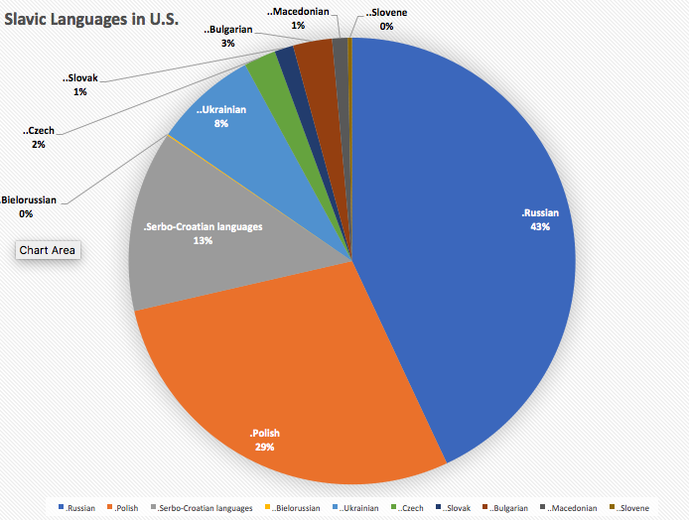
Pie Chart = Table (see WebAim) Slavic Languages in U.S.
Data: U.S. Census Bureau,
2009-2013
Notes:
Pie chart of Slavic languages spoken in U.S. See next slide for data.

Slide 37
Data Table for Slavic Languages Source: U.S. Census
Language | Numbers | Percentage
Russian | 879,434 | 43.02%
Polish | 580,153 | 28.38%
Serbo-Croatian languages | 267,979 | 13.11%
Bielorussian (sic) | 1,805 | 0.09%
Ukrainian | 152,325 | 7.45%
Czech | 47,385 | 2.32%
Slovak | 27,930 | 1.37%
Bulgarian | 57,785 | 2.83%
Macedonian | 22,885 | 1.12%
Slovene | 6,370 | 0.31%
Total | 2,044,051 | 100.00%

Slide 38
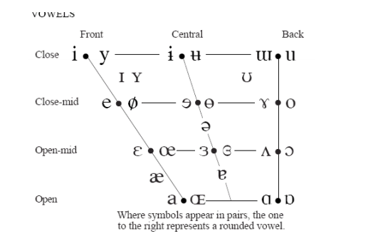
Also a table Vowel “Triangle” Chart
Image from MIT Open Courseware
Height /Backness | Front | Central | Back
Close (High) | i | ɨ (barred i) | u
Close-Mid | e | ʌ (carat) | o
Open-Mid | ɛ (open e) | ə (schwa) | ɔ (open o)
Open (Low) | æ (ash) | a | ɑ (hand a)

Slide 39
Complex Headers? Color names in 4 languages, 2 Romance & 2 Celtic
Manually code each cell, not just headers
Azul: blue, Spanish, Romance

Slide 40
My Solution R = Romance, C = Celtic
Color | French: R | Spanish: R | Welsh: C | Irish: C
Green | Vert | Verde | Gwyrdd/Glas | Glas
Black | Noir | Negro | Du | Dubh
Blue | Bleu | Azul | Glas | Gorm/Glas
Red | Rouge | Rojo | Coch | Ruadh
White | Blanche | Blanco | Gwyn | Fi(o)nn

Slide 41
Conclusions
Tables are not “evil”
BUT…good design is important
Accessible tables benefit everyone
P.S. Can we improve technical symbol support in AT?

