Slide 1
Accessibility Blockers & How to Address them (Politely)
Elizabeth Pyatt, ejp10@psu.edu

Slide 2
Major Blockers (Summarized)
Images (w/o ALT text)
ALT text reads description of image
No Page/Document Titles
No wants to go to “Untitled Page”
And no wants 50 “Penn State” pages
No Headings/Subheadings
Headings read out by screenreaders
Many content providers fail to understand importance of headings
Don’t have to be large to be useful
Notes:
NOTE:
Headings = H1…H6 tags or equivalent in other docs
Headers = Table Headers (TH tags) or top of page area (as embodied in HTML 5 HEADER tag). Yes, it’s confusing (and the two terms are often mixed)

Slide 3
More Blockers
Poor link text
Where is “here”? Read more where?
No Table Headers/Captions
Caption: title of the table
Header: tops of rows, left col
Listing types of data
Poorly labeled form field
Identifies what should go into that blank box
Videos without Captions
Audio without transcripts
See http://accessibility.psu.edu/video
Notes:
This presentation won’t cover video much due to time. Caption group with Pat Besong, Bill Welsh, Mike Brooks, Matt Barkau have information.

Slide 4
CMS Comments
CMS Benefits
Standardize templates, CSS
Some allow control over WYSIWYG editor
CMS Issues
May need to train content providers
ALT tags, subheadings, tables
Not all default templates are accessible
Change templates?
New CMS?
How large is the error?
Compliance Sheriff scores
Some errors false positives or not major
Need to consider resources, impact
Don’t raise CS score if it is detrimental to JAWS user

Slide 5
Image (w/o ALT Tags)
Why it’s a blocker
If it’s not text, it’s not read by the screenreader
Also
Image Maps
Animations
WCAG 2.0
Guideline 1.1.1.—"All non-text content that is presented to the user has a text alternative that serves the equivalent purpose."

Slide 6
ALT Tag/Text/Attribute
Text which replaces image if it’s not visible
Appears when image fails to load
Example (HTML)
<img src=“twtlogo.gif” alt=“TWT Certificate Program logo” title=“Teaching with Technology”>
Title= Tool tip text
Notes:
Source page for TWT Certificate program – http://ets.tlt.psu.edu/twt/ Images in PPT have ALT text. Right click image, select Format then Alt text to view

Slide 7
ALT Tag Style Tips
Concise, but Descriptive
NOT “Our logo” (for what???)
Or use blank ALT tag if information also in text
NOT “Created by ETS. Copyright Penn State” (not the image content)
Not necessary “TWT Certificate program. TWT is written on green chalkboard with USB cables emerging from bottom.” (Wordy)
OK “TWT Certificate Program” (Good choice)
Decorative
Includes toolbars, “smiling customer” images
ALT=“ ” (blank ALT tag)

Slide 8
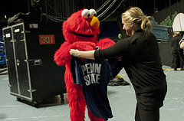
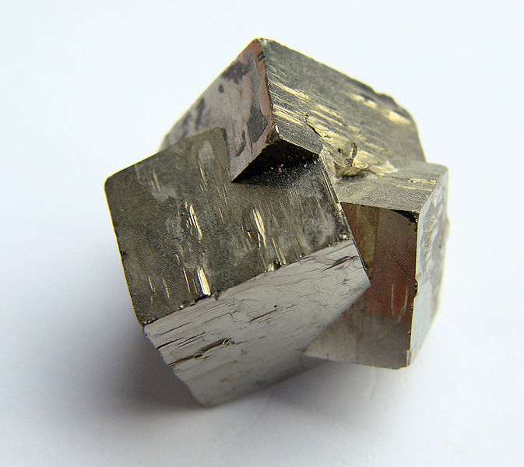
ALT Tag Exercise
E-Commerce Site
Sesame Street Live at BJC Image from Penn State Live
Twinned Pyrite Crystal. Image from Wikipedia
Notes:
Credit cards ALT text – should identify brands, not just say “Credit card image” or “Forms of payment”
BJC Sesame Street Live – Something like “Elmo receiving Penn State T shirt”
Crystal (Technical) – if technical info needed, get from instructor/researcher
Crystal (news story) – something like “Pyrite crystal appears to be 3 metalic cubes merging” or BLANK Alt text

Slide 9
Other Technologies
These also support ALT tags
Microsoft Office
Right click image : Format Image : Alt text
ANGEL/Blogs/CMS editors
Look for Alternative Text or description field
PDF (“Figures”)
Accessibility Panel
Details on http://accessibility.psu.edu/images

Slide 10
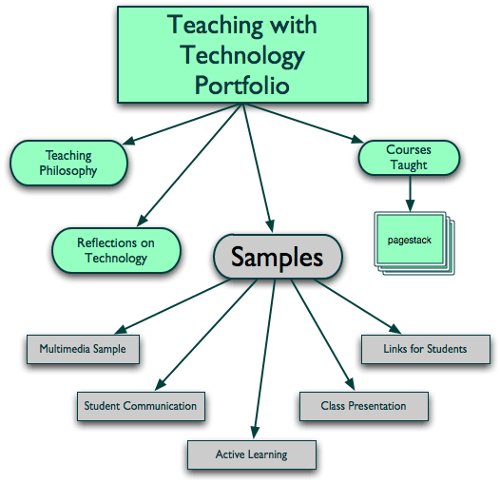
Complex Images
Example Website Architecture Map
Notes:
Source page http://ets.tlt.psu.edu/twt/porOrganization

Slide 11
Strategies
“Long Description”/D-Link
Separate file with description just for those on screen readers
HTML5 deprecating “longdesc”
Describe for everyone
ALT tag points to appropriate section of text
E.g. ALT=“Website concept map. See outline following for details”
Everyone can view description
Not all sighted users process visuals with same degree of ease
NCAM STEM Diagrams
http://ncam.wgbh.org/experience_learn/educational_media/stemdx
Notes:
HTML 5 deprecating LONGDESC because only screen reader users benefit. However, JAWS would probably continue to support it.

Slide 12
Concept Map Image as Text Outline
Teaching Philosophy
Teaching Section
Courses Taught (can include course descriptions and syllabi)
Teaching Awards and Publications
Teaching with Technology Samples
Samples
Course in which it was used
Teaching goal of the sample
captures or actual document (graphics, audio, video, Powerpoint)
Reflections on how technologies worked
Orginal page:
http://ets.tlt.psu.edu/twt/porOrganization
Notes:
http://ets.tlt.psu.edu/twt/porOrganization

Slide 13
Page/Documents Titles
So that…Screen reader user knows location
Unique titles for each page, not just the Website title
Indexed by Google
Which could list your page as “Untitled Page” if you are not careful
WCAG
Guideline 2.4.2–“Web pages have titles that describe topic or purpose.”

Slide 14
How to Fix
Web
<head> <title>Unique Page Title</title> </head>
CMS Systems
Page Title field usually generates <title> and <h1>
Powerpoint
Titles on every slide
So you can determine which slide you’re on….
Word/PDF
Title on first page

Slide 15
Titles for Frames/iFrames
Use TITLE attribute
Use meaningful frame titles
“main_menu”, “content”, “survey”….
NOT “upper-left”,”25781BCD”, “embed”
Examples
<iframe title=”Survey Form" src=“…”>
Google forms accessible, but embedded in iFrame
<frameset>
<frame src="titlebar.html" title=“Titlebar"> …. </frameset>

Slide 16
Headings (H1, H2,…)
Sighted users look for large/colored text to determine section breaks
These should be tagged as H1….H6
Screen readers can list headings as a page map
Changing size/color does NOT count
May need to train content providers to use Headings options
WCAG
WCAG 2.0 Guideline 2.4.6—"Headings and labels describe topic or purpose."
CSS Tips
Don’t have to be large (e.g. side menus)
A few could be invisible (but could be interpreted as spam)
Notes:
CMS note – template makers can provide appropriate templates, but may need to train content providers on which headings to use.

Slide 17
Headings in Disguise
Notes:
Adobe Connect Login page with headings labeled. Image based on WAVE Firefox toolbar

Slide 18
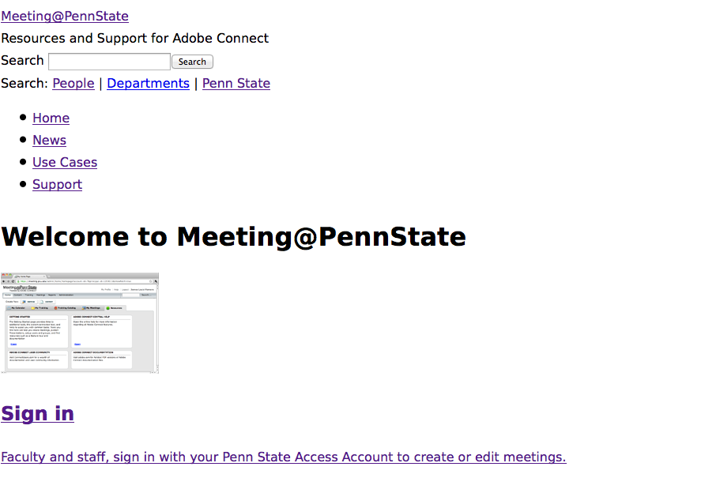
With CSS Disabled
Notes:
Adobe Connect Login page with CSS disabled. Headings remain intact.

Slide 19
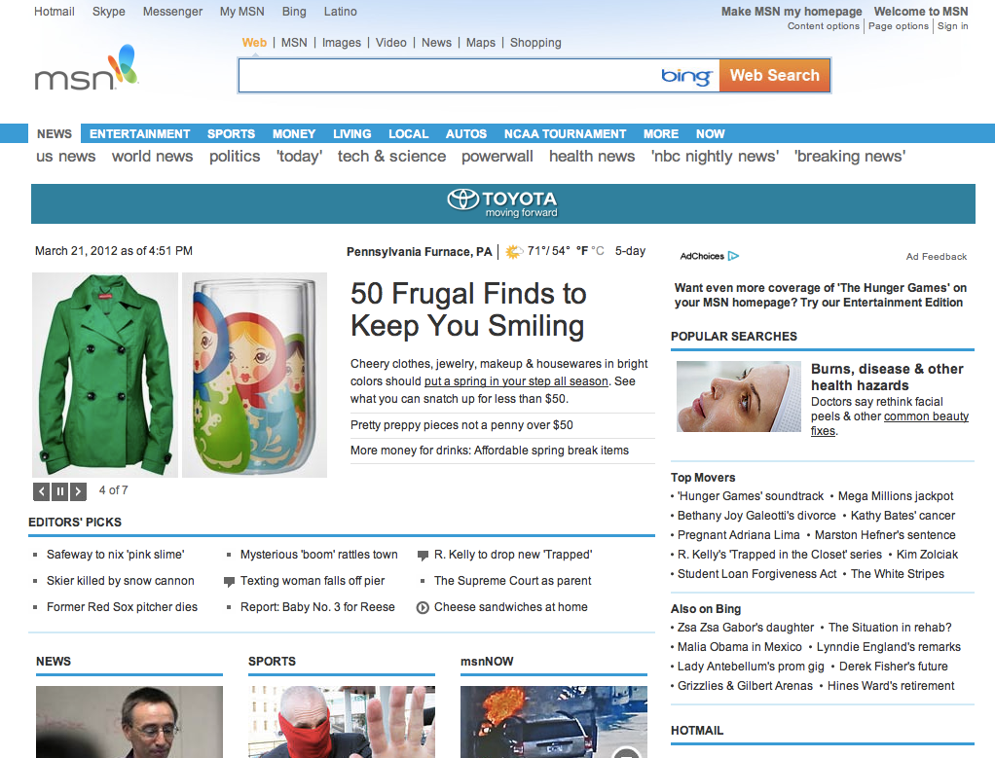
Where should Headings Go?
Notes:
Examples – Headline “50 Frugal Finds”, items with blue line benearth. Hidden heading for tab menus

Slide 20
Nesting of Headings
Nesting Means
H1 (1/page, at very top)
H2…H2…H2
H3…H3…H3 (no skipping to H4)
Nesting issues
CMS often makes page title H1, but places after navigation H2
WCAG includes this as an acceptable template
Compliance Sheriff flags as error
May miss a level depending on CMS
GOOD NEWS: Not a huge blocker
But don’t get lazy
Notes:
Presenters can’t make official recommendations, only suggestions.

Slide 21
Link Text
Screen readers can list links (especially site maps)
Bad style
Click Here… Here… and Here
Multiple Here links hard for motion impaired users because of size
Read More… Read More… and Read More
Good
Read more here from The Penn State Accessibility Website.
Notes:
Question for class: where does each “Here” link and “Read More” link go?

Slide 22
Link Text Issues
CMS generates “Read More” links
Try to make sure headline is also a link
Include headline in “Read More” link
Writers used to “Click Here” structure
Try to reset the “template”
Click here for information on accessibility (BAD)
Go to the Accessibility Page for more information
FYI – most people know that you “click” on a link
Breadcrumb separators
Best Choices are :, :: or
Instead of » (right angle bracket)
> (greater than), not awful but not great
Notes:
Double colon found in WCAG template, but : or right arrow works (and recommended as option by Nielsen). > recommended by some but not all JAWS users like hearing “greater than”

Slide 23
Table Captions/Headers

Slide 24
WCAG Guidelines on TABLEs
2 Guidelines
WCAG 2.0 Guideline 2.4.6—"Headings and labels describe topic or purpose.”
WCAG 2.0 Guideline 1.3.1 - "Information, structure, and relationships conveyed through presentation can be programmatically determined or are available in text.”

Slide 25
Simple vs. Complex Data Tables
Simple Tables
Have no merged cells
Rows represent one type of data
Columns represent another type of data
Are easier to accessify
Are easier for screen readers to process
Complex Tables
Are popular, but not always user friendly
Difficult to maintain code wise
Often based on layout from print sources
We have different options on the Web!

Slide 26
Caption Tag
See the code
<table> <caption>TABLE TITLE HERE</caption> <tr> … </tr> </table>
Want captions beneath TABLE?
<caption align=“bottom”>
Use CSS to format beautifully!

Slide 27
Headers with TH/SCOPE
TH tag (vs. TD)
Designates cell as a header
SCOPE Attribute
<th scope=“col”> for top row
<th scope =“row”> for left side
Some CMS don’t support SCOPE attribute
TH tag most important
Can you cut and poste code from another source?
Dreamweaver supports WYSIWYG edits for TH, SCOPE
View Code
Next slide

Slide 28
Table with Headers Code
<table border="2" summary="Color Table"> <caption> Color Names in Multiple Languages </caption> <tr> <th scope="col">Color</th> <th scope="col">Spanish</th> <th scope="col">French</th> <th scope="col">Irish</th> <th scope="col">Welsh</th> </tr> <tr> <th scope="row">Black</th> <td lang="es">negro</td> <td lang="fr">noir</td> <td lang="ga">dubh</td> <td lang="cy">du</td> </tr> ... </table>

Slide 29
Other Table Tags
SUMMARY Attribute
<table summary=“text for screenreaders…”>
Invisible by default
Deprecated in HTML5, but would still probably work
ID/Header
Used in cells of complex tables to match headers and cell
Each cell needs IDs to match a HEADER
http://accessibility.psu.edu/tablecomplexhtml

Slide 30
Table Troubleshooting
http://blogs.tlt.psu.edu/projects/accessibilitydemo/DW/tablefix1.html
http://blogs.tlt.psu.edu/projects/accessibilitydemo/DW/tablefix2.html
http://blogs.tlt.psu.edu/projects/accessibilitydemo/DW/tablefix3.html

Slide 31
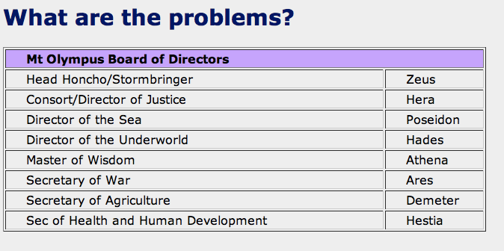
TABLE Troubleshooting 1
Notes:
Problems: No header row. First row is 2 merged cells.

Slide 32
Add Styled Captions, Headers
Notes:
Purple tab is a styled Caption tag with CSS3 rounded Border. Looks OK even without rounded border.

Slide 33
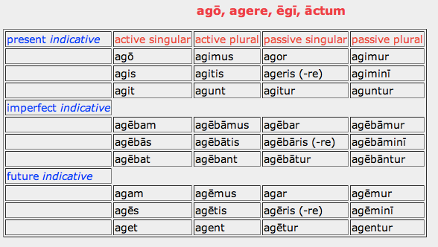
Troubleshooting 2: Latin Verb Table
Notes:
Issues – Headers and captions yes, but not all rows have headers. Also many rows have merged cells

Slide 34
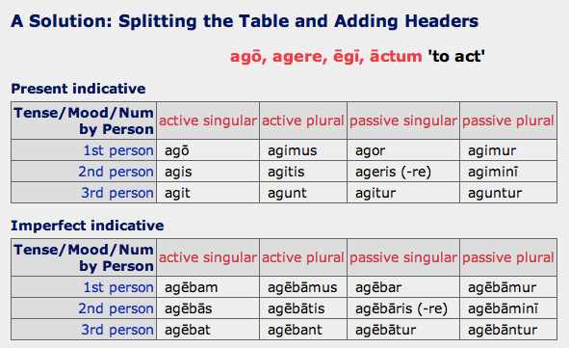
Splitting Tables
Each table captioned
Can combine with appropriate headings (H3/H4)
Notes:
Row headers added. Each table has a caption to indicate tense. English translation of verb added also

Slide 35
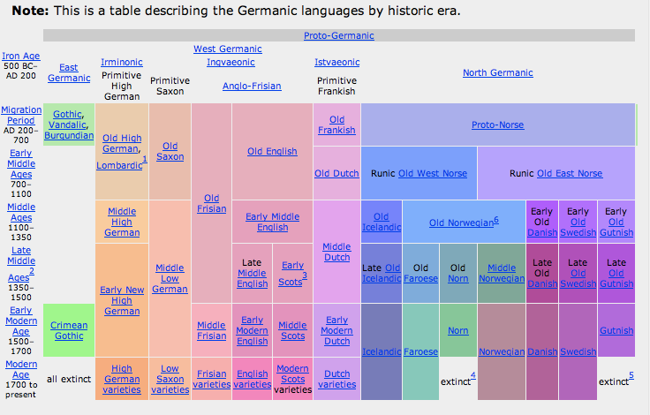
Very Very Complex Table

Slide 36
Maybe it’s a List
Proto Germanic (750 BC - 1 AD)
East Germanic (1 AD - 300 AD)
Gothic† (mostly extinct by 9th century AD)
Vandalic† (extinct by 6th century AD)
Burgundian (extinct by 6th century AD)
Crimean Gothic†
West Germanic (1 AD - 300 AD)
Irminonic (High German) to Old High German to German
Istaevonic/Franconian to Old Frankish to Middle Dutch
Dutch
Afrikaans
Ingvaeonic
Old Saxon to Low German/Saxon
Anglo-Frisian
Old Frisian to Modern Frisan
Old English
Scots
English

Slide 37
Forms in WCAG 2.0
Label everything CORRECTLY
WCAG 2.0 Guideline 1.1.1– "If non-text content is a control or accepts user input, then it has a name that describes its purpose.”
WCAG 2.0 Guideline 3.3.2— "Labels or instructions are provided when content requires user input. ”
WCAG 2.0 Guideline 4.1.2— "For all user interface components (including but not limited to: form elements, links and components generated by scripts), the name and role can be programmatically determined.”

Slide 38
Properly Labeled Forms
Enclosed in FORM tag
When FORM tag skipped, JAWS does not enter forms mode.
Labeling means
Mechanism exists to match form field with identifier
In HTML use LABEL tag
<form> <label for "yourname"> Your Name </label> <input type="text" name="yourname” id="yourname”> </form>

Slide 39
Required Fields
When a field is required
Indicate it with text (*/”Required”)
Formatting alone insufficient
Include that symbol in the LABEL tag
<label for "yourname”>*Your Name </label> <input type="text" name="yourname” id="yourname”>
Instructions
Should be before FORM tag
Text not in LABEL or LEGEND Tag (next slide) is NOT read in JAWS.

Slide 40
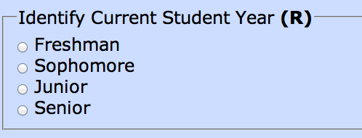
Checkboxes/Radio Buttons
Each option (radio button) needs LABEL
Question in FIELDSET (rectangle) in LEGEND text
(R) = required field

Slide 41
Checkboxes/Radio Buttons Tags
Each selection needs a LABEL
LABEL can follow object
<input type=“radio” id=“freshman”… /> <label for “freshman”>Freshman</label>
Fieldgroup/Legend
Used to group fields & radio but /checkboxes
<fieldset> <legend>Current Year <b>(R)</b></legend> … </fieldset>
Include Required Field text symbol in LEGEND
Format changes alone not sufficient for screenreader

Slide 42
Other Tips
Always include Go/Submit/Submit button (i.e. no autosubmit)
Screen readers often accidentally autosubmit
If selection range is small use radio buttons instead of dropdown
Easier for screen readers and some learning disabilities

Slide 43
Search Forms
Which search form is likely to have correct label?
Notes:
Second option – “Search this site” in Labek, then field, then Search button.

Slide 44
Batch Edit
Design so that object and options are close together
ANGEL object name followed by links for actions
Action and selection of blog object separated
Notes:
For second option, JAWS users have to select an action first, then determine which blog entry the action applies to, then has to return to Go button
Sighted users probably select entries, then action, then Go.

Slide 45
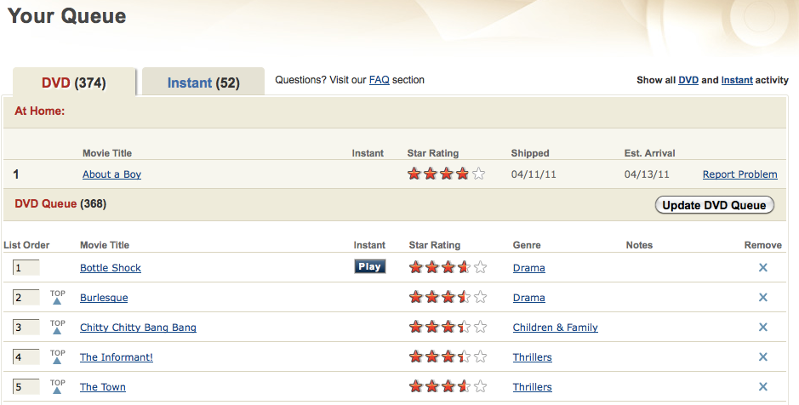
Drag and Drop
Allow for text-based actions as well as drag and drop
Notes:
Netflix allows you to switch movie order in queue in a text box (but also allows drag and drop)

Slide 46
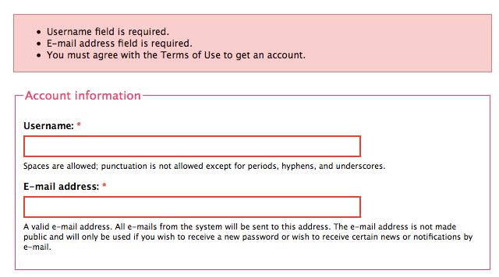
Indicating Errors
Error reports
Should identify fields with errors
Use text, not just formatting
Bad examples: http://blogs.tlt.psu.edu/projects/accessibilitydemo/DW/formsreqerror.html
Notes:
Error form indicates which fields needs to be filled and that you must click to agree to usage terms.

Slide 47
Conclusion
Read your Compliance Sheriff reports carefully
They point to code in question
Adjust core templates
Content providers may need some training
Learn to incorporate low hanging fruit into workflow
Breathe!
We have until October 15, 2014

Slide 48
Firefox Testing Toolbars
Favorite Firefox Toolbars
WAVE – http://wave.webaim.org/toolbar
FAE –
https://addons.mozilla.org/en-US/firefox/addon/accessibility-evaluation-toolb/
JuicyStudios (Color/ARIA) –
https://addons.mozilla.org/en-US/firefox/addon/juicy-studio-accessibility-too/
Jim Thatcher (Tables/ARIA)
http://jimthatcher.com/favelets/
AccessAbility Site
http://accessibility.psu.edu/headings
http://accessibillity.psu.edu/linktext

